Slide 1
Weekly Update 2
Sarang Deb Saha

Slide 2
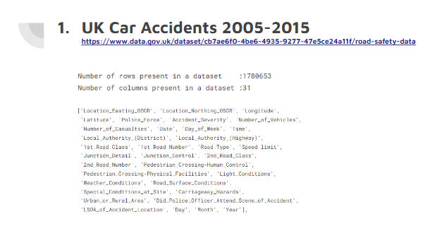
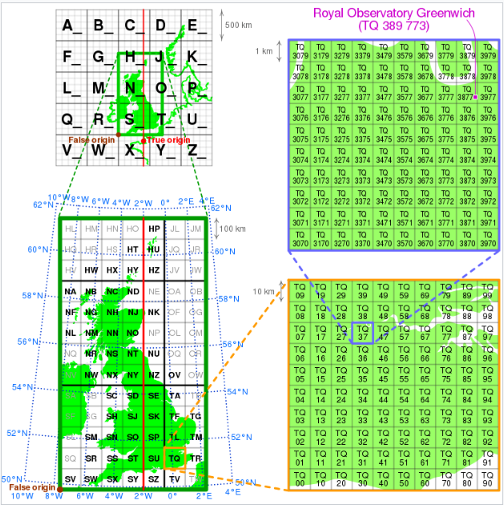
Insights from last week’s presentation-
OSGR: Ordnance Survey National Grid

Slide 3
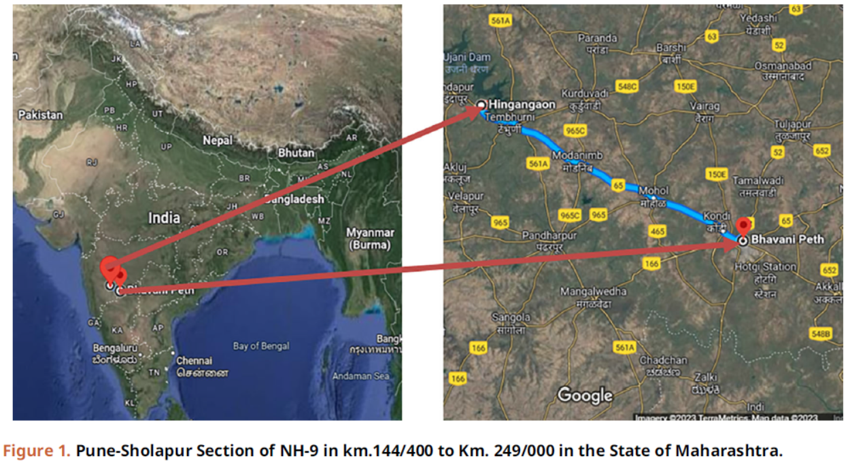
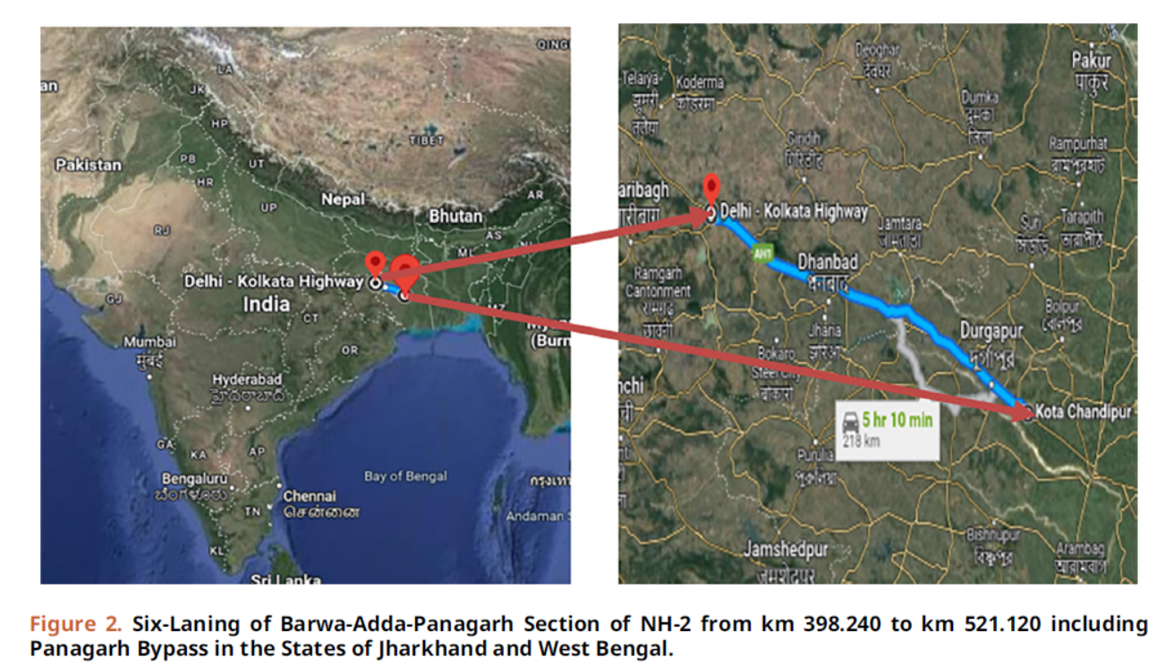
Paper referred:
Khanum, H., Garg, A. and Faheem, M.I., 2023. Accident severity prediction modeling for road safety using random forest algorithm: an analysis of Indian highways. F1000Research, 12, p.494.

Slide 4
Source data:
Data on road accidents from selected stretches of highways was obtained from the Concessionaires of the National
Highways Authority of India (NHAI) for two projects: Pune-Solapur and Bengal (BAEL) Section. For the Pune-Solapur
Section of NH-9, which is located between km. 144/400 and km. 249/000 in the state of Maharashtra, accident dates from
2013 to 2018 were used. For the Six-Laning of Barwa-Adda-Panagarh Section of NH-2, which includes Panagarh Bypass
and is located in the States of Jharkhand and West Bengal Stretch, accident dates from 2015 to 2019 were used for the
stretch between km 398.240 and km 521.120. The raw data was subject to exploratory data analysis, as detailed in the
following section.

Slide 5
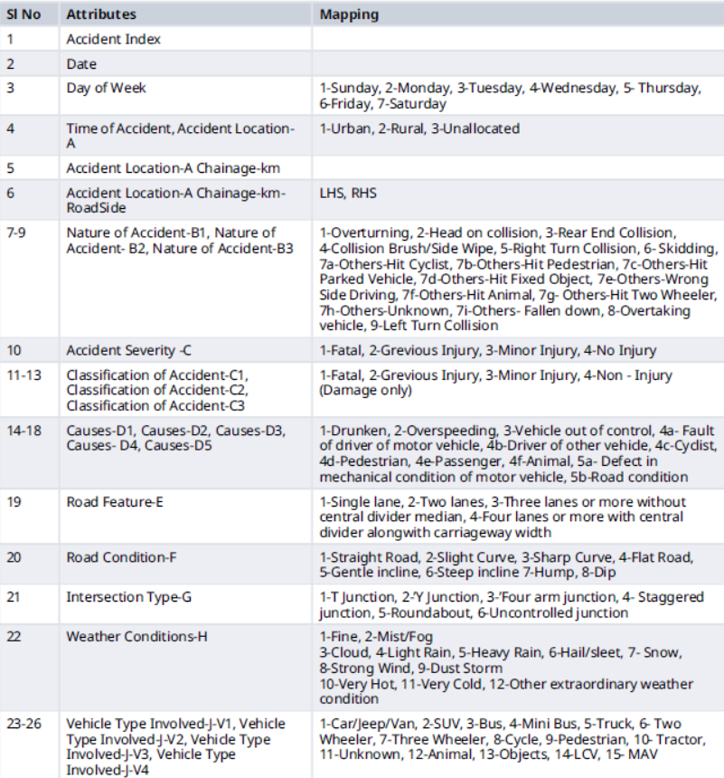
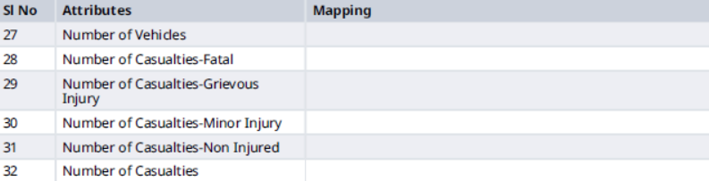
Dataset Information:

Slide 6
3257 instances of road accidents and in general, the model frequently predicts a severity index of 2 for accidents, even when the observed values are distinct.
This may indicate a bias in the model, possibly as a result of an imbalance in the training dataset, in which severity index 2 occurs more frequently than other categories.

Slide 7
Results of Random Forest Classifier
The RF classifier model predicted the severity of traffic accidents with an overall accuracy of 67% on the training set and approximately 41.47% on the test set.

Slide 8
Added models to the existing work
Random Forest Classifier
AdaBoost Classifier
XGBoost Classifier
SVM (Support Vector Machines)
The SVM Classifier implemented performed better than the aforementioned Random Forest model.
Using the same GridSearchCV method for hyperparameter tuning it gave a 45.17% accuracy on the test set.

